Slide 1

Wear′s the Party!
Paul Lammertsma
CTO, Pixplicity

Slide 2
Wear’s the Party!
Paul Lammertsma
CTO, Pixplicity

Slide 3
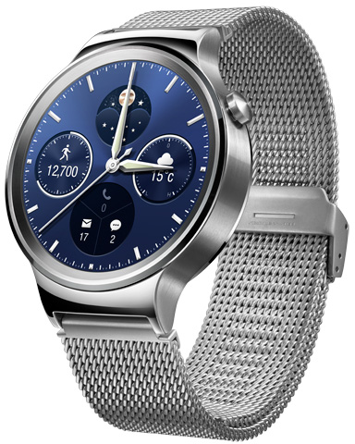
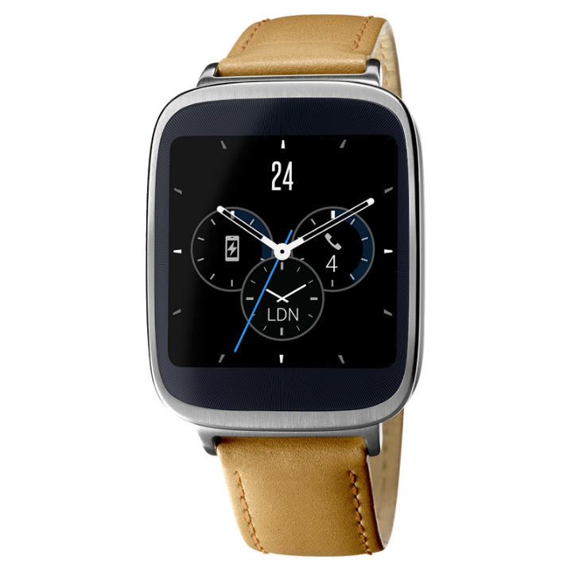
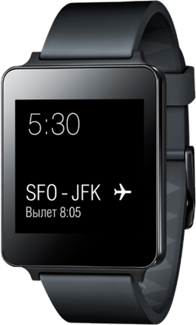
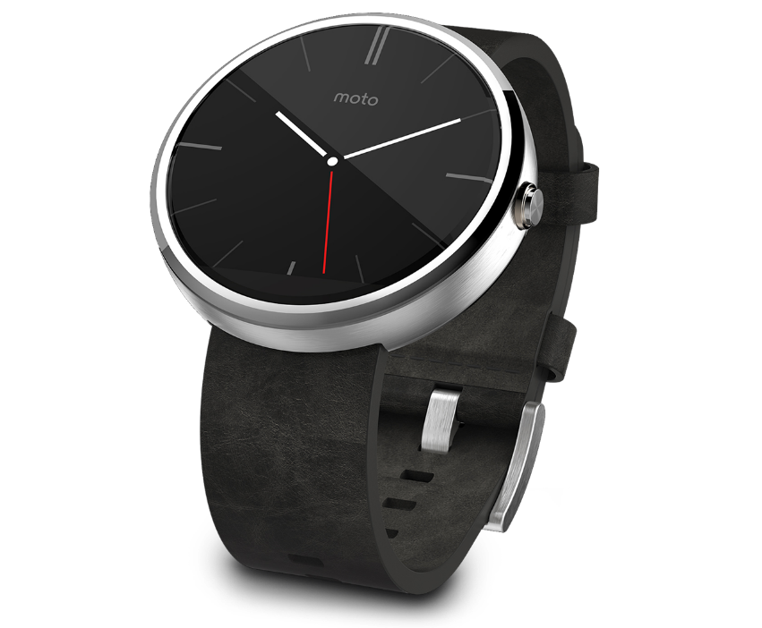
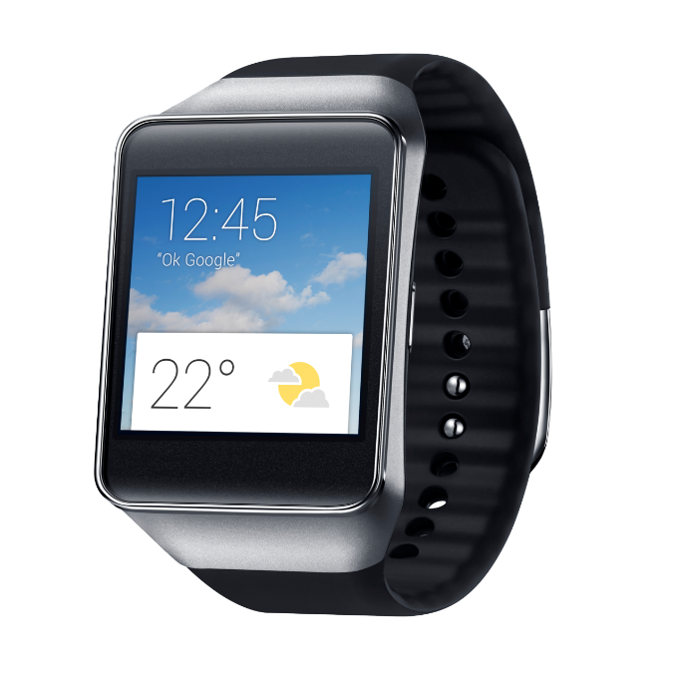
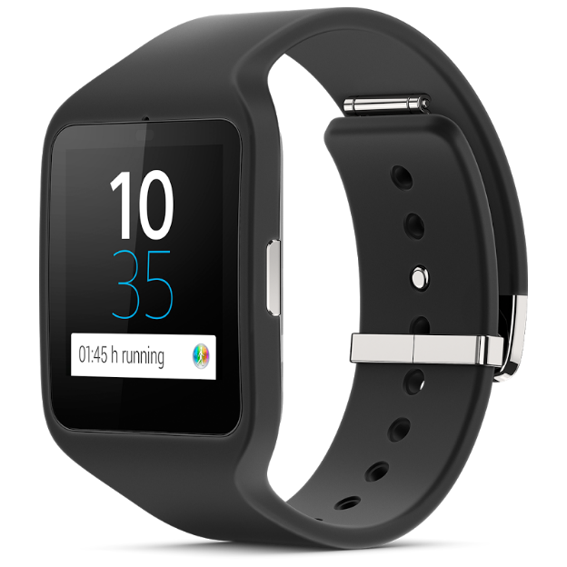
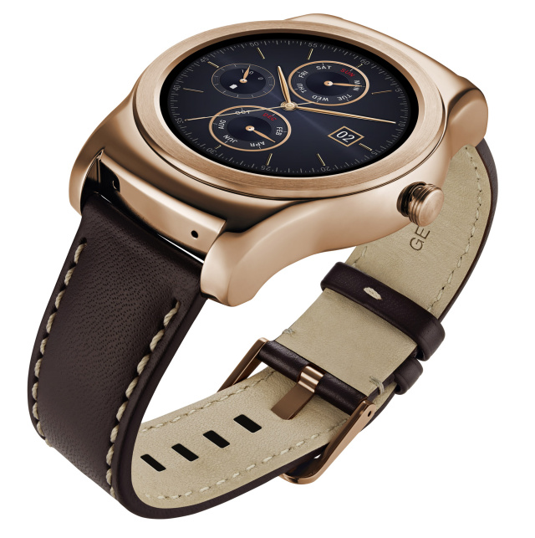
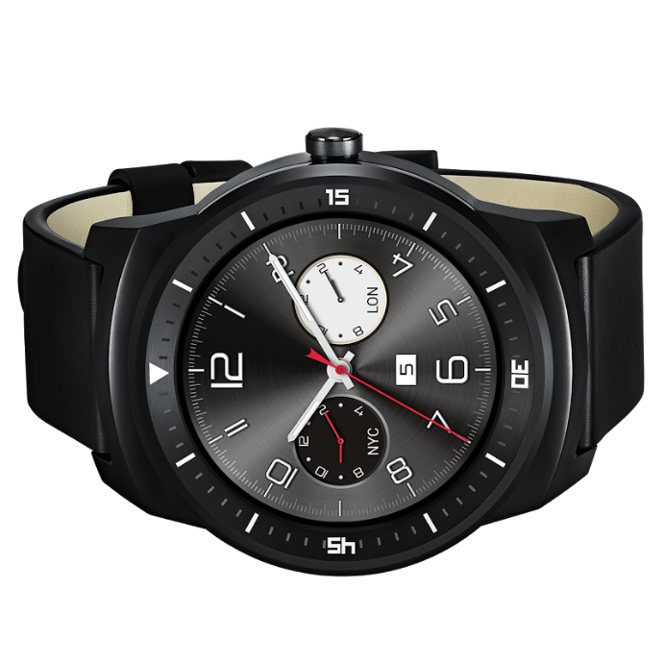
Notes:
The party started in March 2014.
Left to right: Sony Smartwatch 3, Samsung Gear Live, Asus Zenwatch, LG G Watch, LG Watch Urbane, Motorola Moto 360, (front) LG G Watch R

Slide 4
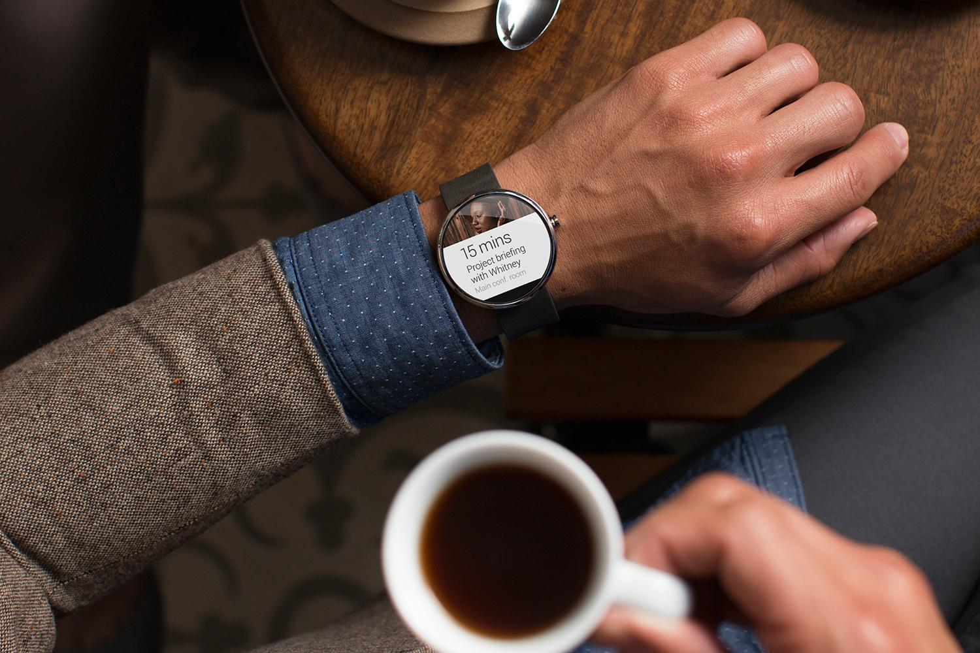
Short demo

Slide 5
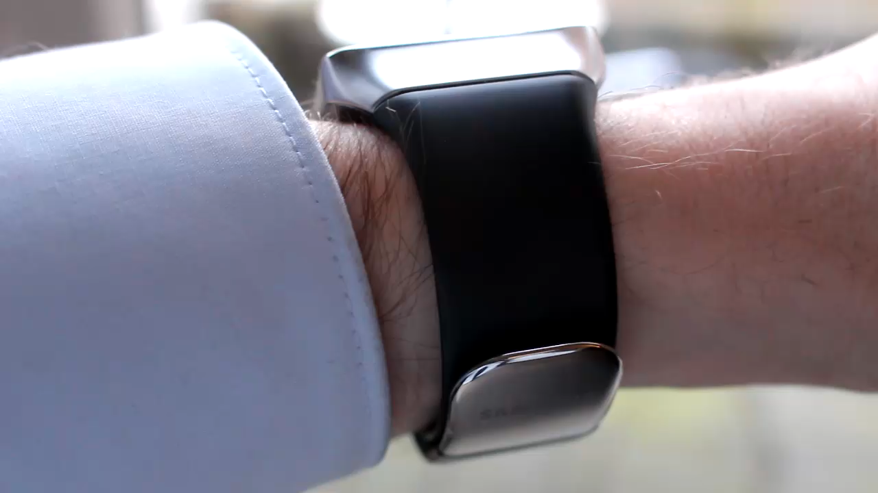

Slide 6
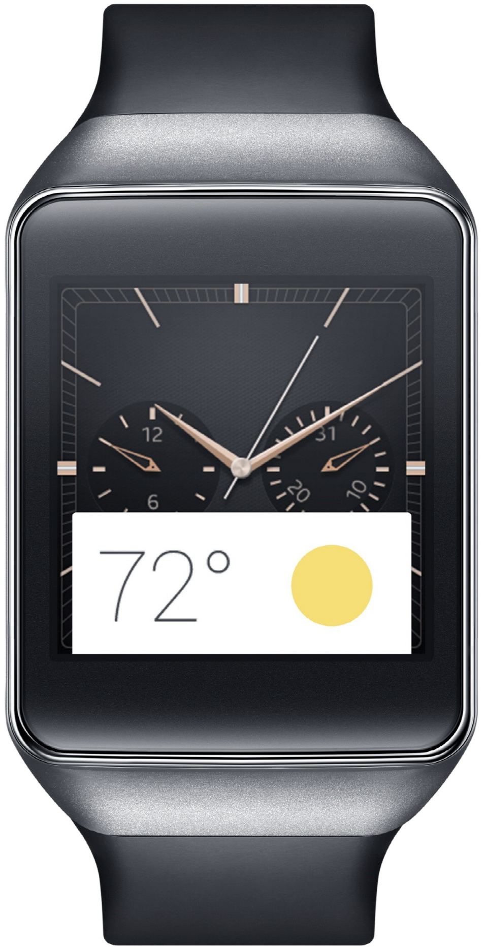
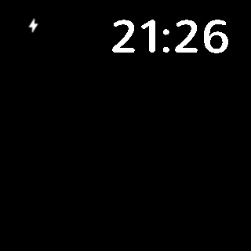

Slide 7
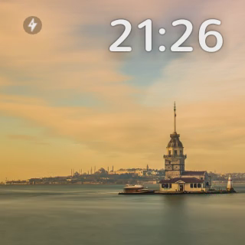

Slide 8
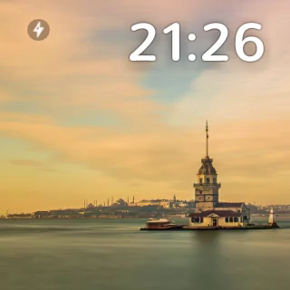

Slide 10
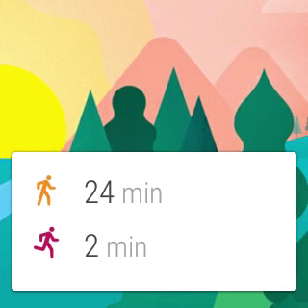

Slide 11
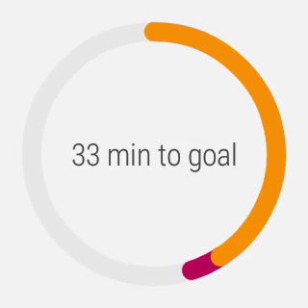

Slide 12
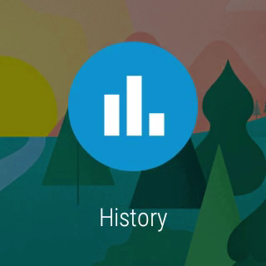

Slide 13
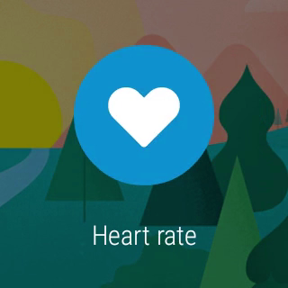

Slide 14
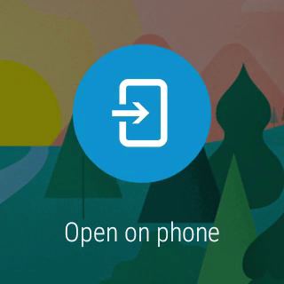

Slide 15
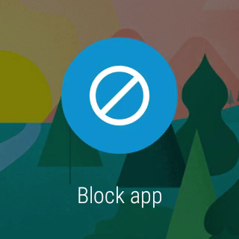

Slide 16
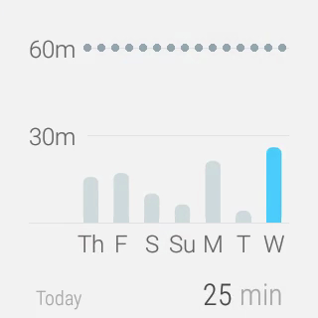

Slide 17
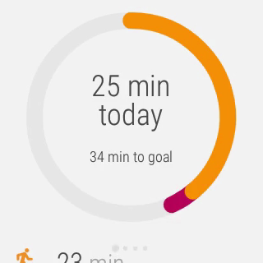

Slide 19

Creative vision

Slide 20
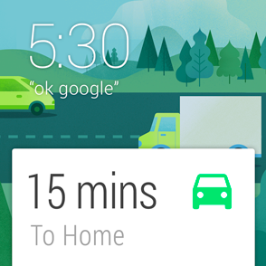
Launched automatically
Cards appear on the stream when they become relevant
“Android Wear is timely, relevant and very specific.”
Notes:
“Android Wear is timely, relevant and very specific.”

Slide 21
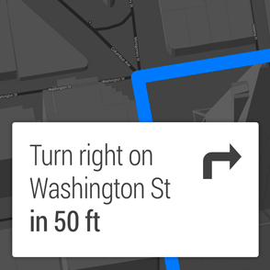
Glanceable
See information in a split second
“Android Wear is fast, sharp, and immediate.”
Notes:
“Android Wear is fast, sharp, and immediate.”

Slide 22
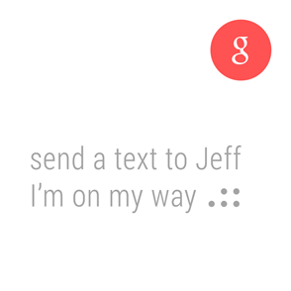
Suggest and demand
Only interrupts you when necessary and always on hand to provide an answer
“Android Wear is helpful, respectful, and responsive.”
Notes:
“Android Wear is helpful, respectful, and responsive.”

Slide 23
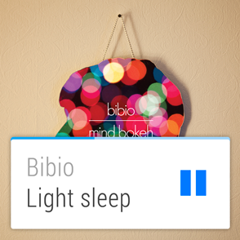
Zero or low interaction
Input rarely needed, and avoids fine-grained finger movements
“Android Wear is gestural, simple, and fast.”
Notes:
“Android Wear is gestural, simple, and fast.”

Slide 24

Under the hood

Slide 25
It’s Android
Android-powered wearable on your wrist
Running 5.0 Lollipop
Unified experience between different manufacturers
Specially designed apps for Wear
…but you don’t need to go hunting for them

Slide 26
It’s not a replacement
Connected to phone or tablet
Requires Android 4.3+
Portal to the internet
Mirrors notifications
Apps with Wear features magically work

Slide 27
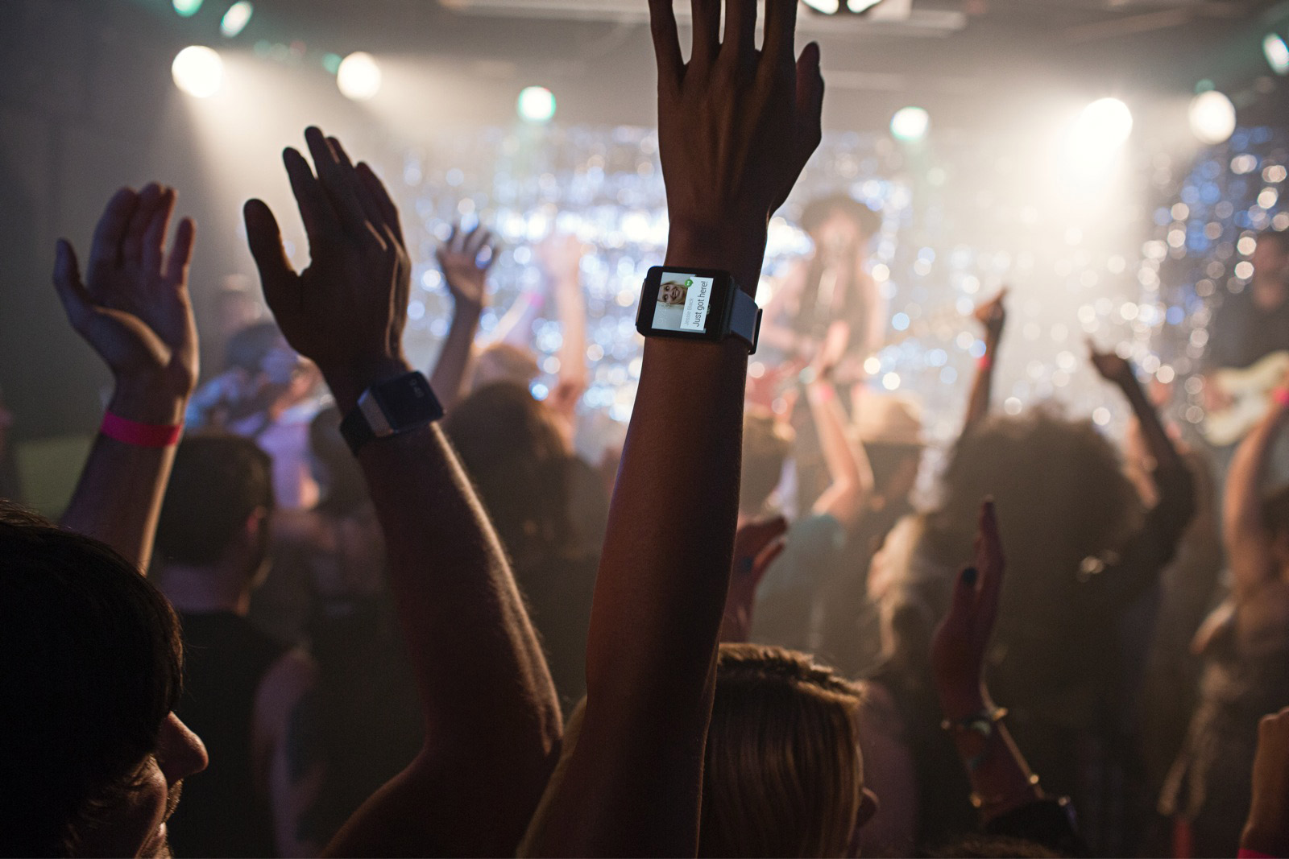
Watchfaces Notifications Wear apps

Slide 28
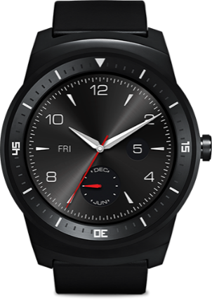
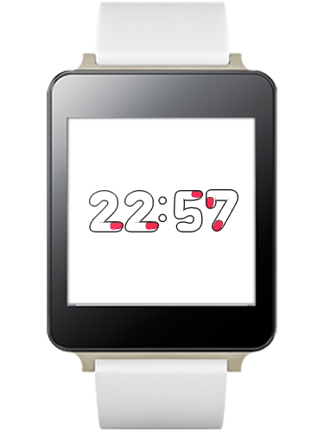
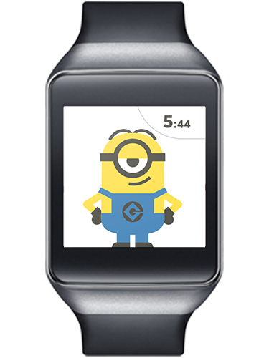
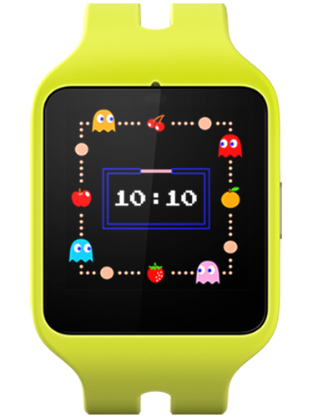
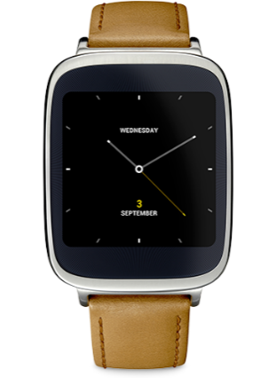
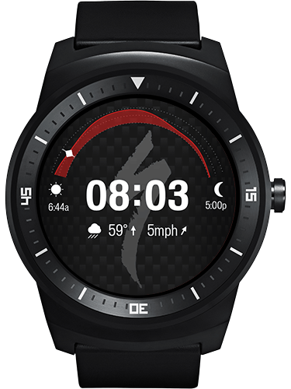
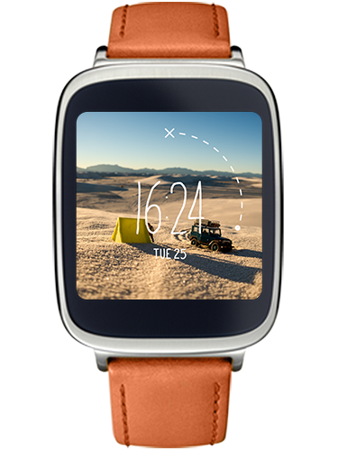
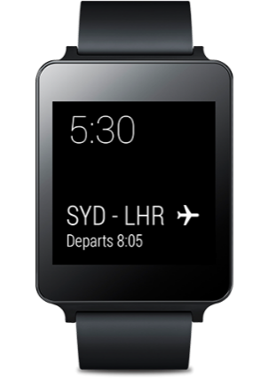
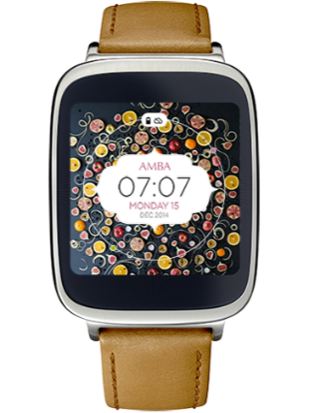
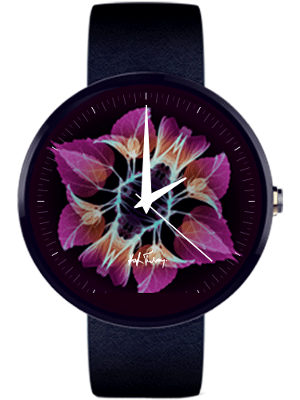
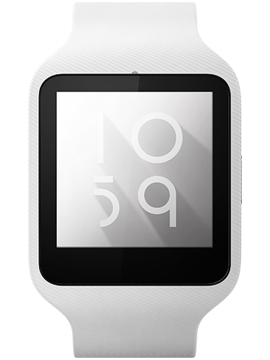
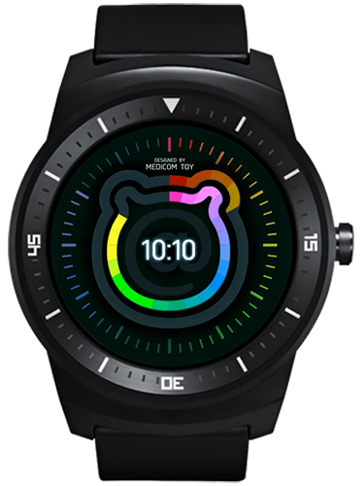
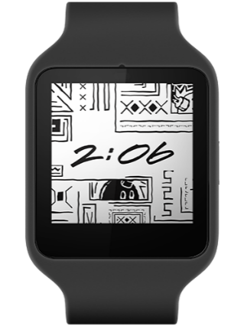
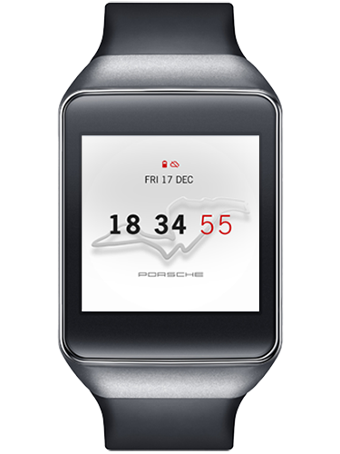
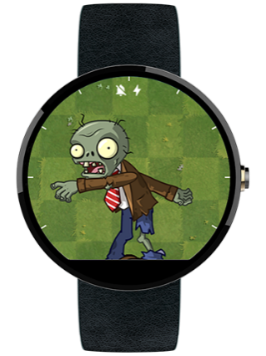
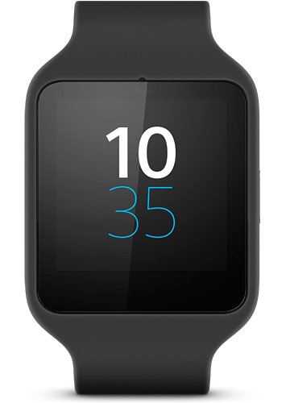
Watchfaces
Notes:
Custom watchfaces.

Slide 29
Watchfaces
Until Lollipop, no standard
Draws on a OpenGL-backed canvas inside a Service

Slide 30
Watchfaces
public class AnalogWatchFaceService extends CanvasWatchFaceService {
@Override public Engine onCreateEngine() { // Provide your watch face implementation return new Engine(); } ... }

Slide 31
Watchfaces
CanvasWatchFaceService.Engine provides callbacks for
Initializing your watch face
Obtaining device properties (e.g. burn-in screen, low-bit ambient mode)
Time changes
Entering and exiting ambient mode
Draw passes
Visibility changes

Slide 32
Watchfaces
private class Engine extends CanvasWatchFaceService.Engine { ... @Override public void onDraw(Canvas canvas, Rect bounds) { // Draw your watch face } ... }

Slide 33
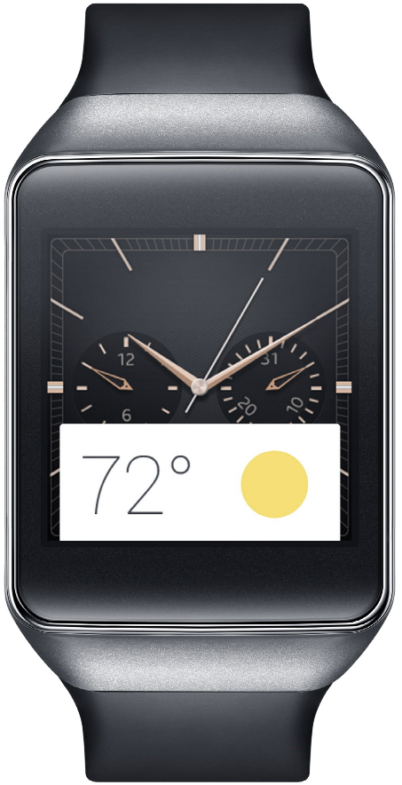
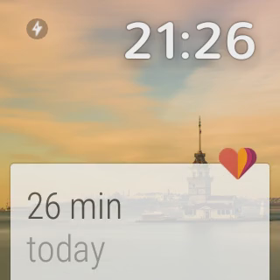
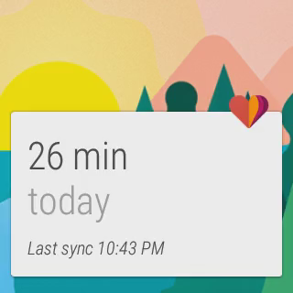
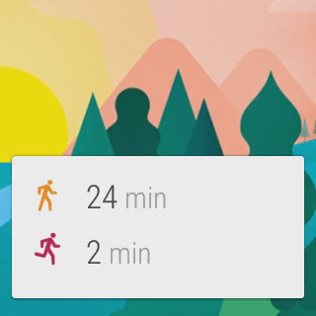
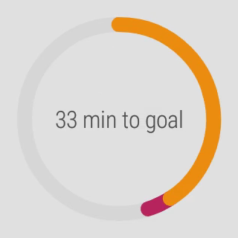
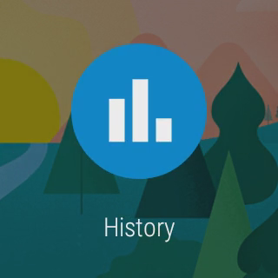
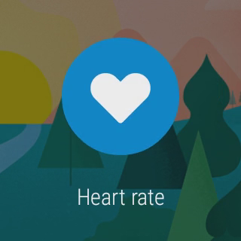


Notifications

Slide 34


Notifications
NotificationCompat works “out of the box”
}
}
}
Title, description and icon
Actions
Reserved actions

Slide 35
Notifications
Pages
DisplayIntents (requires Wear app)
Notes:
Pages: supplementary information / detail card. For instance weather
DisplayIntents: completely custom tailored views

Slide 36
Notifications
with NotificationCompat
NotificationCompat.Builder notificationBuilder = new NotificationCompat.Builder(this); notificationBuilder .setSmallIcon(R.drawable.ic_event) .setContentTitle(eventTitle) .setContentText(eventLocation) .setContentIntent(viewPendingIntent);

Slide 37
Notifications
with NotificationCompat
// Get an instance of the NotificationManager service NotificationManagerCompat notificationManager = NotificationManagerCompat.from(this); // Build the notification and issue it with the manager notificationManager.notify( notificationId, notificationBuilder.build());

Slide 38


Notifications
with NotificationCompat

Slide 39
Notifications
with NotificationCompat
NotificationCompat.Action action = new NotificationCompat.Action.Builder( R.drawable.ic_map, getString(R.string.map),
mapPendingIntent).build() // Add the action button notificationBuilder .addAction(action);

Slide 40

Notifications
with NotificationCompat

Slide 41
Enriching notifications
just for wearables
// Add functionality for wearables WearableExtender wearableExtender = new NotificationCompat.WearableExtender() // Add an action button, but only on wear wearableExtender.addAction(action); notificationBuilder .extend(wearableExtender);

Slide 42
Enriching notifications
just for wearables
final Bitmap background = BitmapFactory.decodeResource( context.getResources(), R.drawable.im_backdrop); // Add a pretty background wearableExtender.setBackground(background);

Slide 43


Enriching notifications
just for wearables

Slide 44
Enriching notifications
Voice reply
Add RemoteInput to Reply action
action.addRemoteInput( new RemoteInput.Builder(EXTRA_REPLY_TEXT) .setLabel(getString(R.string.replyLabel)) .setChoices(…) .build();

Slide 45
Enriching notifications
Voice reply
Modify handheld app to use reply text
Bundle results = RemoteInput.getResultsFromIntent(intent); if (results != null) { String message = results.getString(EXTRA_REPLY_TEXT); }

Slide 46



Enriching notifications
Voice reply

Slide 47
Enriching notifications
Pages
More information without requiring app on handheld
For instance:
Contents of an email
Calendar events
Chat history

Slide 48
Enriching notifications
Pages
Notification chatHistory = new NotificationCompat.Builder(context)
.setStyle(new NotificationCompat.BigTextStyle() .bigText(getChatHistory())) .build(); wearableExtender.addPage(chatHistory);

Slide 49


Enriching notifications
Pages

Slide 50

Wear apps

Slide 51

Wear apps

Slide 52


Wear apps

Slide 53

Wear apps

Slide 54
Wear apps
Installed on the wearable
Bundled in the mobile’s APK
Inside res/raw

Slide 55
Wear apps
Included in the mobile’s build.gralde: wearApp project(':wear')
Included in the wear’s manifest: <uses-feature android:name="android.hardware.type.watch" />

Slide 56

Wear apps

Slide 57






Wear apps

Slide 58

Enriching notifications
DisplayIntents

Slide 59
Enriching notifications
DisplayIntents
Wear app must create the notification itself
DisplayIntent references an Activity and draws it
Different sizes: XSMALL, SMALL, MEDIUM, LARGE, FULL_SCREEN

Slide 60
Enriching notifications
DisplayIntents
wearableExtender .setCustomSizePreset( Notification.WearableExtender.SIZE_FULL_SCREEN) .setDisplayIntent( PendingIntent.getActivity( context, 0, new Intent( context, FullscreenActivity.class), 0));

Slide 61
Enriching notifications
DisplayIntents
<activity android:name="com.example.MyDisplayActivity" android:exported="true" android:allowEmbedded="true" android:taskAffinity="" android:theme="…" />

Slide 62



Slide 63

Debugging
Attach the watch via USB
Enable ADB debugging on the wearable
Approve your machine’s RSA signature in the pop-up

Slide 64
Debugging
Attach the watch via USB
Enable debugging on the wearable:
Tap the home screen twice to bring up the Wear menu.
Scroll to the bottom and tap Settings.
Scroll to the bottom and tap the Developer Options. If there's no Developer Options item, tap About, and then tap the build number 7 times.
Enable ADB debugging.

Slide 65

Debugging
Approve your computer’s RSA signature in the pop-up on your phone

Slide 66
Debugging over Bluetooth
Enable Bluetooth debugging on the wearable
Attach the handheld via USB
Run: adb forward tcp:4444 localabstract:/adb-hub adb connect localhost:4444
Approve your machine’s RSA signature in the pop-up

Slide 67
Debugging over Bluetooth
Enable Bluetooth debugging on the wearable:
Tap the home screen twice to bring up the Wear menu.
Scroll to the bottom and tap Settings.
Scroll to the bottom and tap the Developer Options. If there's no Developer Options item, tap About, and then tap the build number 7 times.
Enable Debug over Bluetooth.

Slide 68
Debugging over Bluetooth
Connect the handheld to your machine over USB
Run: adb forward tcp:4444 localabstract:/adb-hub adb connect localhost:4444
Approve your computer’s RSA signature in the pop-up on your phone

Slide 69

Tips
Use a common project to share constants between your wear and handheld projects
Take special considerations for round devices
…and almost round devices

Slide 70
Gotchas!
Properly packaging a wearable app
Declare the wearable app module in the handheld app: wearApp project(':wearable')
The handheld and wearable apps have the same
Package name
Version number
All permissions declared in the wearable app must also be declared in the handheld app
Sign both apps and assemble the release variant

Slide 71
Gotchas!
Turn off asset compression
The wearable app is located in res/raw
It’s already compressed
Any other installation problems
Look at the PackageUpdateService tag in Logcat

Slide 72
Useful stuff
Android Training “Building Apps for Wearables” http://developer.android.com/training/building-wearables.html
Design Guide “Watch Faces for Android Wear” https://developer.android.com/design/wear/watchfaces.html
Android Developers YouTube channel https://www.youtube.com/user/androiddevelopers

Slide 73


Added value

Slide 74
Wear’s the Party!
Source code & slides: http://github.com/Pixplicity/weardemo
Paul Lammertsma
CTO, Pixplicity

Slide 75
Wear′s the Party!
Source code & slides: http://github.com/Pixplicity/weardemo
Paul Lammertsma
CTO, Pixplicity
@officesunshine

